Slide 1
Women in Computing
Done by: Gerda Bortsova
Notes:
Hello, My name is Gerda and I’m going to deliver a presentation about women in computing.
I’m going to present on the topic women in computing.

Slide 2
What questions I will try to answer:
Why many people (including me) view a decreased participation of women in computer science (and STEM – Science, Technology, Engineering and Mathematics in general) as problem? Why it could be regarded as a question of ethics, whether to direct efforts to help this problem or not?
Why there are so few women in IT (STEM)?
What could we increase number of women in computer science?
Notes:
What questions I’ll try to answer/address in my talk/this presentation
The first is why do I think disparity between men and women/decreased participation of women in Computer science is a problem?
Why do I speak about this in a seminar about Ethics?

Slide 3
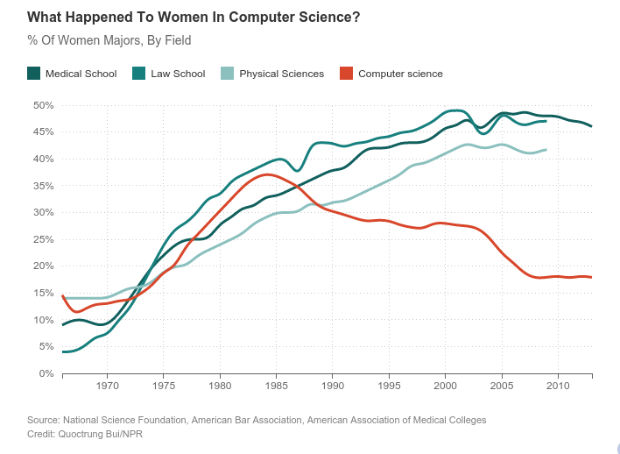
Some figures
(See [1].)
Notes:
First of all, I want to give you some figures on proportion of women in computer science. This is historical data.
Decline – maybe because of appearance of personal computer, which was marketed to boys.
In computer science, maybe more than in other fields, prior experience with computing plays important role.

Slide 4
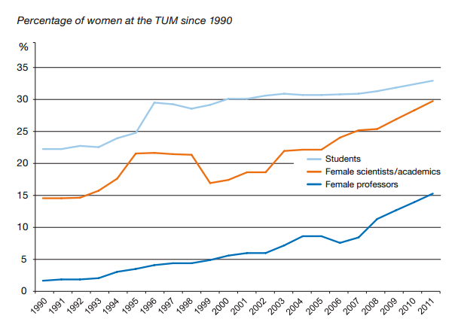
TUM Figures
33% of students,
39% of PhD students,
33% of scientists,
14% of professors are female. [2]
Taken from [3].
Notes:
The higher you go into hierarchy, the fewer women you’ll find.

Slide 5
TUM Figures: by major overall [2]
Students by Department | % of females | Students by Department | % of females
Architecture | 56% | Munich School of Engineering (MSE) | 31%
Chemistry | 41% | Physics | 18%
Civil, Geo and Environmental Engineering | 34% | Sport and Health Sciences | 53%
Electrical, Electronic and Computer Engineering | 14% | TUM School of Education | 63%
Informatics | 16% | TUM School of Life Sciences Weihenstephan | 53%
Mathematics | 30% | TUM School of Management | 33%
Mechanical Engineering | 14% | TUM School of Medicine | 62%

Slide 6
TUM Figures: PhD by major [2]
Department | % of female | Department | % of female
Architecture | 50%
Chemistry | 39% | Physics | 18%
Civil, Geo and Environmental Engineering | 22% | Sport and Health Sciences | 54%
Electrical, Electronic and Computer Engineering | 9% | TUM School of Education | 92%
Informatics | 8% | TUM School of Life Sciences Weihenstephan | 55%
Mathematics | 29% | TUM School of Management | 42%
Mechanical Engineering | 15% | TUM School of Medicine | 61%

Slide 7
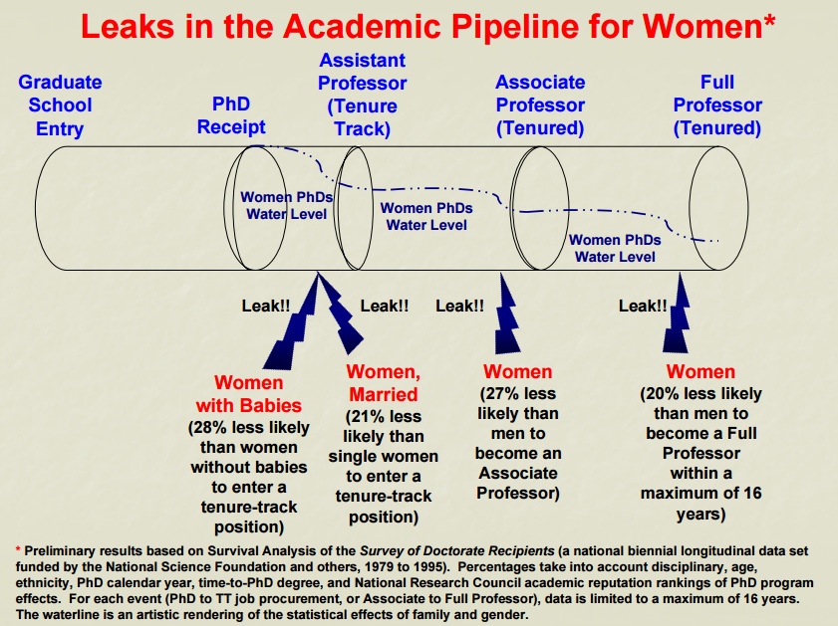
Taken from [4].
Notes:
Question of underrepresentation of women is not only about that women don’t pursue IT careers, but also about that they are leaving the field. Referred to as leaky pipeline.
Of course, it varies by country, but almost every where women are significantly underrepresented in IT.

Slide 8
Why is this a problem?
According to prediction, in USA by 2018 there will be 1.4 million open technology jobs in the United States and, at the current rate of students graduating with degrees in computer science, only 61% of those openings will be filled—and just 29% of applicants will be women. [5, 6]
In Scotland, a large number of females graduate in STEM subjects but fail to move onto a STEM career compared to that of men. According to The Royal Society of Edinburgh, this represents a £170 million per annum loss to Scotland's national income. [7]
A supply of IT professionals doesn’t meet a growing demand.
Notes:
I’ll first examine the most “pragmatic” reasons.
What people frequently provide as a reason:
If to think of a problem from point of view of a single country, to withstand the competition with other countries, add people from minorities.
With increasing number of women in IT, you can help economics.

Slide 9
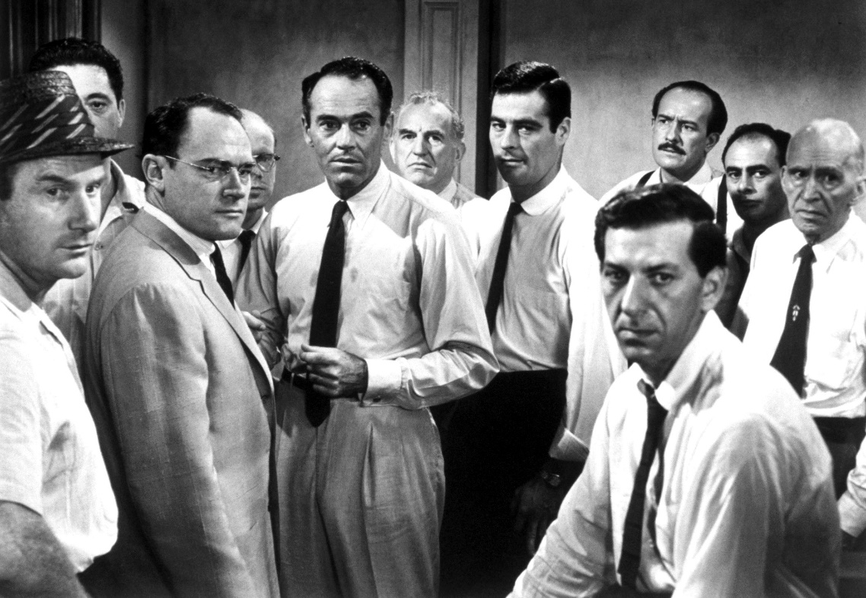
Why is this a problem? II
A number of studies show, that diverse teams perform better. [8]
Diversity could be seen as antidote to so-called groupthink.
Women can actually make computer science better!
Notes:
Groupthink is a psychological phenomenon that occurs within a group of people, in which the desire for harmony or conformity in the group results in an irrational or dysfunctional decision-making outcome.
Women can make computer science better.

Slide 10
Why is this a problem? III
34% higher return investment when women are in leadership positions. [6]
40% higher citation for patents with women co-inventors vs. those with men only inventors. [6]

Slide 11
What are the ethical implications? I
Social inequality
STEM fields provide a great number of good jobs, including highly prestigious and well-paid
In the future, a huge shortage is predicted:
E.g., a 2012 report from the President’s Council of Advisors on Science and Technology indicates that training scientists and engineers at current rates will result in a deficit of 1,000,000 workers to meet United States workforce demands over the next decade. [9]
Notes:
I’ll move on now what is actually WRONG (wrong from ethical point of view) with having women underrepresented in STEM and computer science in particular.
The disparity of men and women in these fields contributes to social inequality.
Unfortunately, many women loose these opportunities.

Slide 12
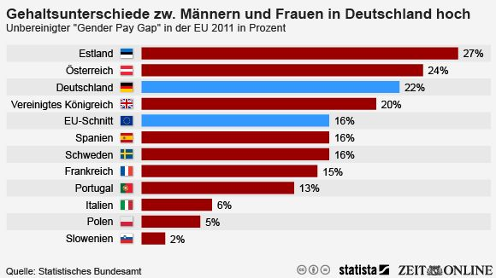
The pay gap
Germany: > 3,000 euro gap in annual salary in IT field
Notes:
Speaking about well paid jobs, the pay gap still persists. Partially it’s coming from horizontal segregation in labor market bw men and women. That is male-dominated professions tend to be better paid.

Slide 13
What are the ethical implications? II
The pay gap and overall low representation of women in higher levels in the hierarchy of many professions may also a consequence of discrimination.
Example:
In one study (2012) the researchers asked 127 faculty members of reputable research-intensive American universities to evaluate an application of a student. All respondents received the same documents, except that student’s name was randomly assigned to be either male or female. [9]
Notes:
Just to show you that discrimination of women really exists and it is quite significant.

Slide 14
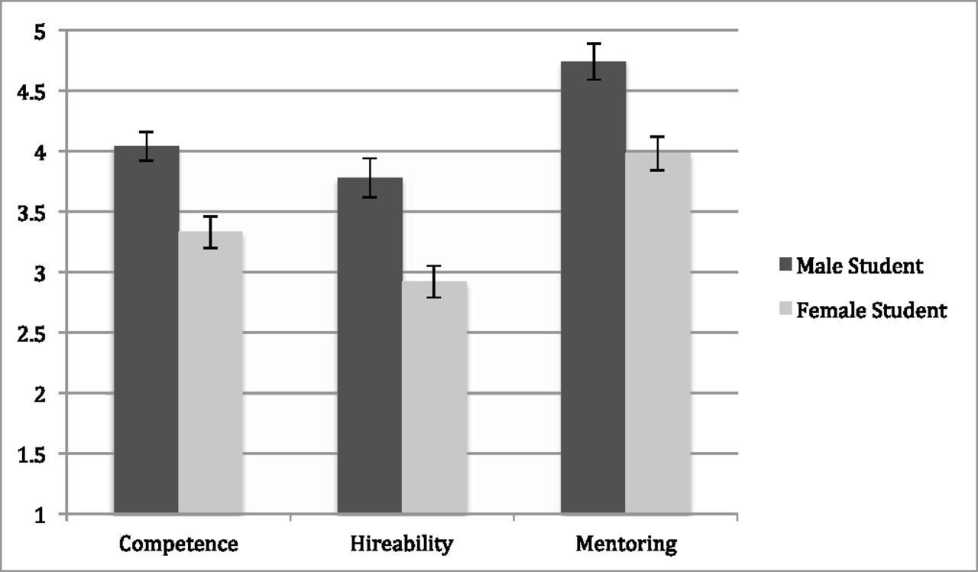

Competence, hireability, and mentoring by student gender condition (collapsed across faculty gender).
Corinne A. Moss-Racusin et al. PNAS 2012;109:16474-16479
©2012 by National Academy of Sciences
Notes:
The respondents evaluated the competence of student, probability to be hired and how much support they would provide him or her.
Competence, hireability, and mentoring by student gender condition (collapsed across faculty gender). All student gender differences are significant (P < 0.001). Scales range from 1 to 7, with higher numbers reflecting a greater extent of each variable. Error bars represent SEs. n_{malestudentcondition} = 63, n_{femalestudentcondition} = 64.

Slide 15
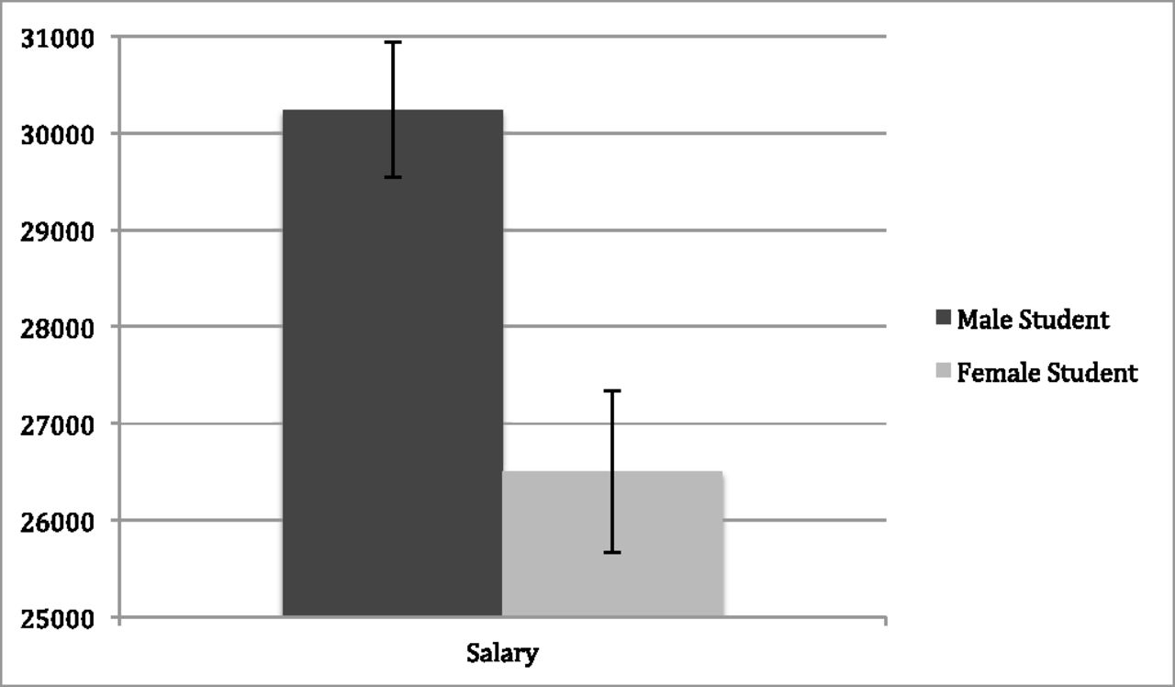
Salary conferral by student gender condition (collapsed across faculty gender).
Corinne A. Moss-Racusin et al. PNAS 2012;109:16474-16479
©2012 by National Academy of Sciences
Notes:
They also gave an approximation of salary for a student. As you may see, on average they would agree to pay almost 5,000 dollars more to a male, than to female student.
Salary conferral by student gender condition (collapsed across faculty gender). The student gender difference is significant (P < 0.01). The scale ranges from $15,000 to $50,000. Error bars represent SEs. n_{malestudentcondition} = 63, n_{femalestudentcondition} = 64.

Slide 16
What are the ethical implications? III
Social inequality:
Lower wages
Lower influence in society
Introduction of suffering:
Hindrances on the way of unlocking potential of women
Obstacles towards living out plans or dreams of women
Lower self-esteem
Increased anxiety
Notes:
Before I was talking about why I think that underrepresentation of women in IT and STEM is an instance of social inequality.
And that discrimination of women contributes to this inequality even more.
The reasons which drive away women from computer science may make women suffer in direct or indirect way.

Slide 17
What are the reasons which drive women away from computer science (and STEM)?
Psychological phenomena like self-fulfilling prophecy and stereotype threat, which could contribute to lesser attractiveness of computing for women, employ stereotypes.
A stereotype is a widely held but fixed and oversimplified image or idea of a particular type of person or thing. [Google Dictionary]
People use stereotypes as heuristics (i.e. cognitive shortcuts) when making decisions in social situations.

Slide 18
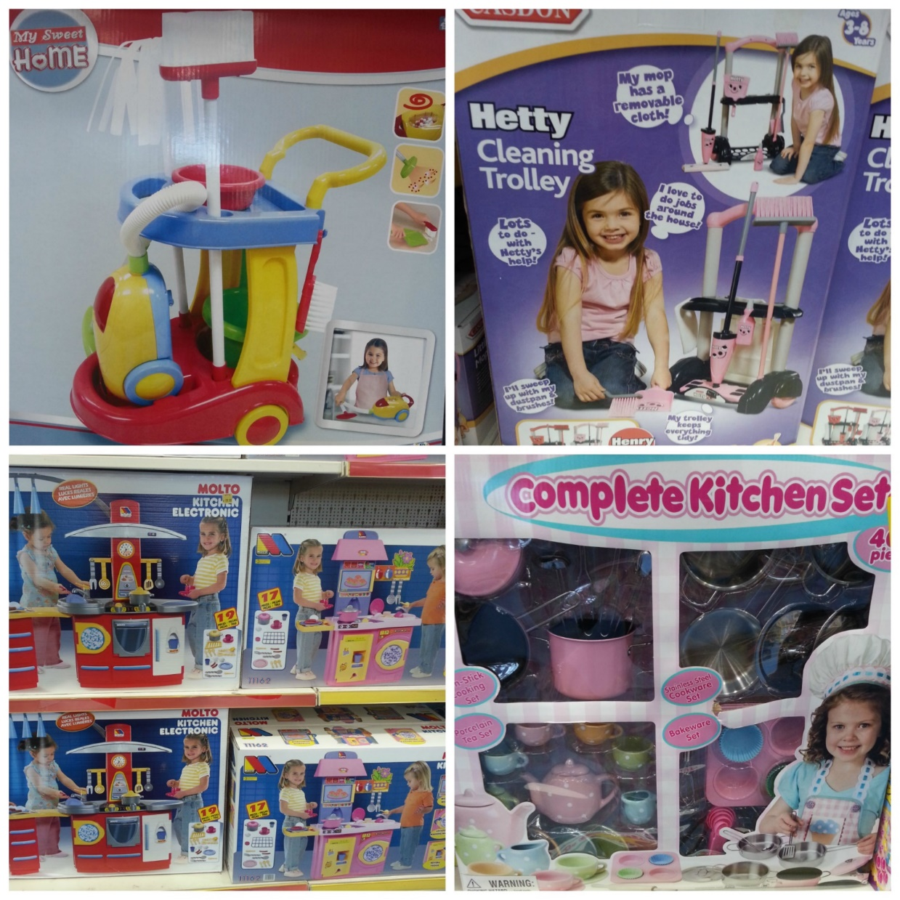

Stereotypes: may originate from childhood
Notes:
We already have different vision of what little boys and girls should be interested in. It is exhibited in toys they buy.
You may see at the left, girls’ toys are very much about cleaning and cooking.

Slide 19


Stereotypes: may originate from childhood
Girls are more expected to stay at home, speaking with adults and reading books
Boys are more expected to do outdoor activities, in particular play games in teams
Notes:
Parents and teachers may have expectations of what activities children like to be engaged in and encourage them to do these activities.
By the way, some people argue, that this may be a reason for girls score higher in tests for verbal abilities, and boys - for spatial.

Slide 20

Girls want to be gorgeous, boys want to be clever
Notes:
The society has expectations of what qualities girls and boys want to develop.

Slide 21
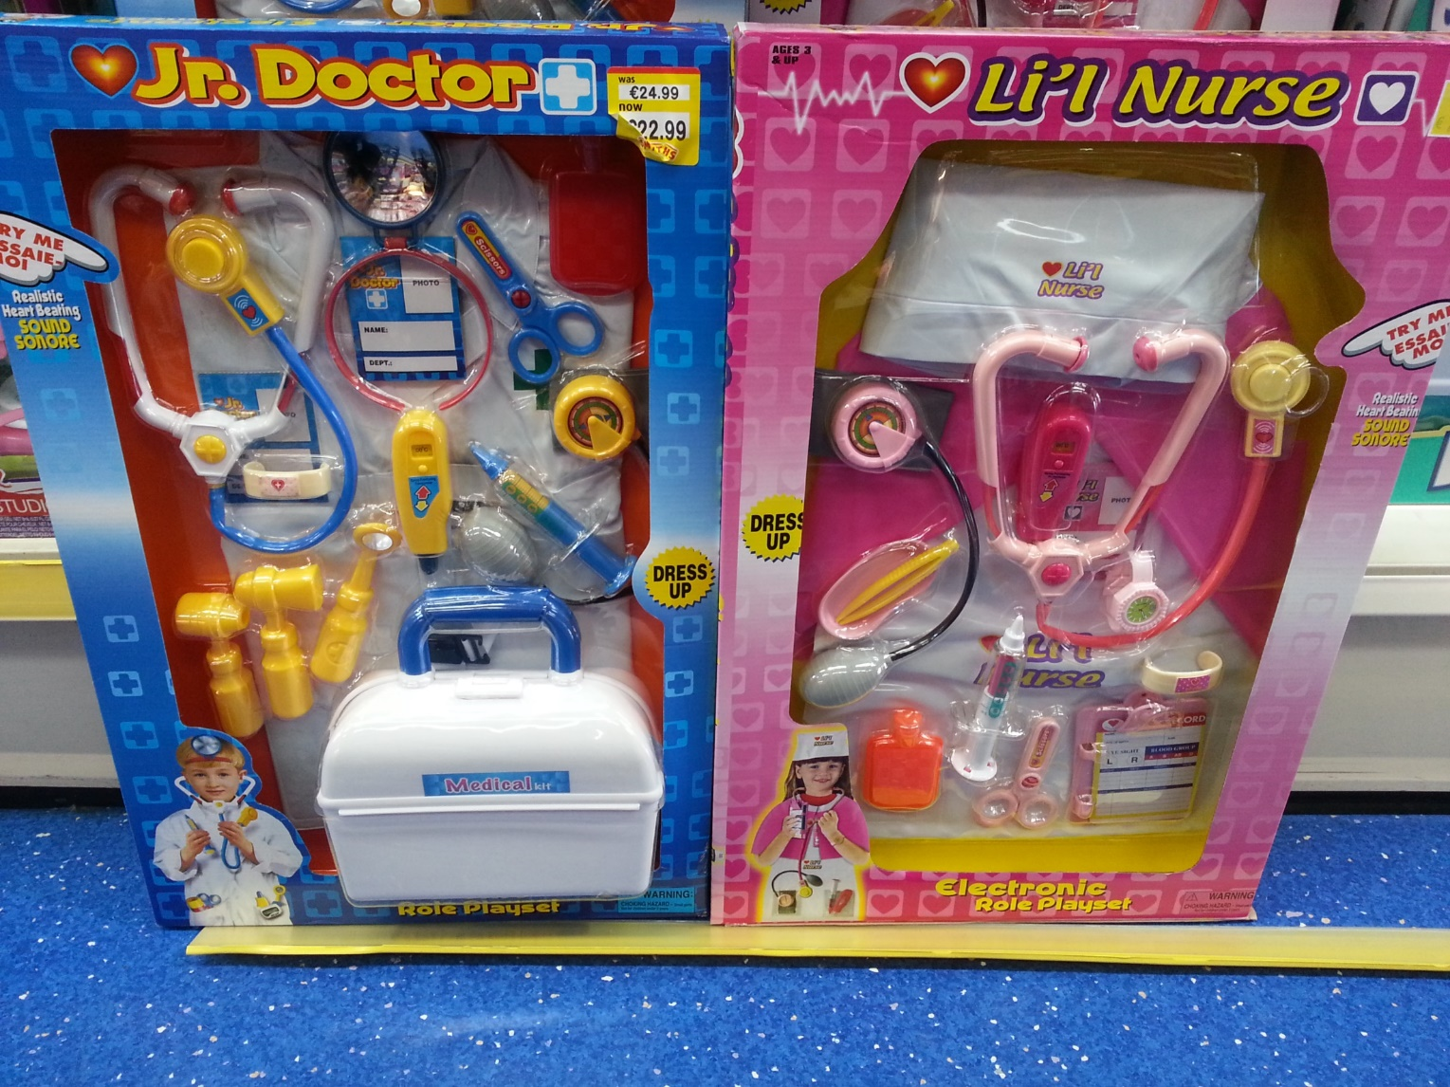
Boy will become a doctor, girl will be a nurse
Notes:
And it has expectations of what kind of jobs they will do.

Slide 22
Stereotypes against women: interests
Men prefer working with things, women prefer working with people.
When interests were classified by RIASEC type (Realistic, Investigative, Artistic, Social, Enterprising, Conventional), men showed stronger Realistic and Investigative interests, and women showed stronger Artistic, Social, and Conventional interests.
Sex differences favoring men were also found for more specific measures of engineering, science, and mathematics interests. [10]
Notes:
This stereotype is something which some studies confirm.
This is a reason some people use to explain disparity between men and women in STEM fields. For sure, it’s not the only ground.
First of all, here we have a reason to suspect, that it is society, which programs men and women to be like this, provided that males and females from early childhood are treated very differently.

Slide 23
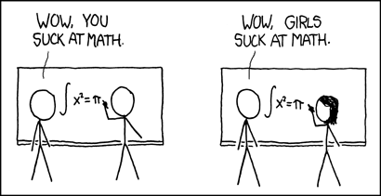
Stereotypes against women: abilities
Women have less intrinsic aptitude for mathematics, science, programming, etc.
Whereas boys’ successes in math are attributed to ability, girls’ successes are attributed to effort; conversely, boys’ failures in math are attributed to a lack of effort and girls’ failures to a lack of ability. [link]
Women are less competent professionally. (E.g., learned from the study about discrimination.)

Slide 24
Stereotypes against women: behavior
Women should be quiet and obedient.
Teachers are more likely to accept questions from boys while telling girls to wait for their turns. [link]

Slide 25
Stereotypes: how close to the reality? I
Biological differences were the most popular explanation for decreased participation of women in science, medicine, etc. before 20th century. [link]
Female and male brains are indeed different.
In particular, in weight number of cells, quantity of grey matter in different areas in brain. [link]
However, scientists cannot yet say much about how that differences affect intellectual abilities (or preferences).
Notes:
Some scientists of 19th - beginning of 20th centuries concluded that female brains are sadly deficient, and women are just not apt to do mathematics or science.
Since that time, science has made very much progress.

Slide 26
Stereotypes: how close to the reality? II
Experiments with infants:
Research didn’t confirm that male infants are more interested in objects, and female infants are more interested in people. [link]
Meta-analyses of tests on various abilities:
No large overall differences in mathematical skills, verbal ability or visuospatial skills found.
However, many studies show, that girls score slightly higher in verbal ability and boys in spatial ability tests. [links]

Slide 27
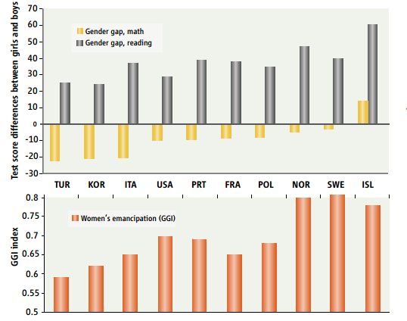
Stereotypes: how close to the reality? III
Some researchers claim that differences in aptitude for certain tasks between sexes has genetic basis. [link]
But there is a good argument against this claim: some studies show, that gender differences in test performance change from country to country and correlate well with such measures of women emancipation as GGI (Gender Gap Index). [link]
Notes:
BUT there is a good argument against the claim that difference in aptitude for certain tasks

Slide 28
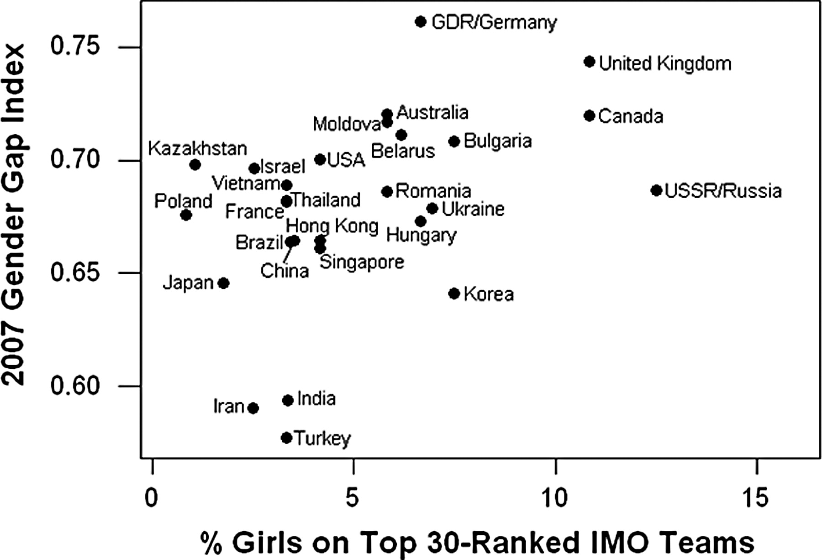
Presence of females on top 30-ranked IMO teams strongly correlates (r = 0.44, P < 0.05) with measures of gender equity within countries.
Janet S. Hyde, and Janet E. Mertz PNAS 2009;106:8801-8807
©2009 by National Academy of Sciences
Notes:
Presence of females on top 30-ranked IMO teams strongly correlates (r = 0.44, P < 0.05) with measures of gender equity within countries. The IMO data for percentage of girls on countries' teams from 1989 to 2008 were taken from Table 4. The GGIs were taken from ref. 30.

Slide 29
What are the reasons which drive women away from computer science (and STEM)?
Lack of interest
Socio-psychological reasons:
Low perceived ability in computing/science/mathematics [link]
Low representation of women in these fields [8]
Lack of role models
Self-fulfilling prophecy
Stereotype threat
Notes:
Low perceived ability correlates with decision of choosing career for women. [link]
Diversity breeds diversity. Low representation of people of the same identity can be perceived as a signal “I’m not welcome here”.

Slide 30
Self-fulfilling prophecy
Expectancies people have towards others may lead to a behavior confirming these expectancies.
Classical experiment of Rosenthal & Jacobson (1968):
The researchers gave an IQ test to elementary school children
They gave to the teachers of the school a list of “high-scorers”, which were, however, chosen randomly, rather than on the basis of test results
Year after these children really showed significantly better improvement in comparison with “average” children

Slide 31
How these expectancies are transmitted?
People can subconsciously behave in a way to trigger the behavior they expect from the other person.
If you think I’m talkative, you may behave in a way that encourages me to speak more.
If students think their teacher is mean, they may act in a way to cause him/her to be mean.
If parents of a girl think she is reluctant to use computer, they may act in a way to cause her feeling reluctance when facing computer.
Notes:
You may wonder, how these expectancies can be really transmitted from a teacher to student, if they are unspoken? People cannot read each other minds.
The probable answer is that people can subconsciously behave in a way to trigger the behavior they expect from the other person.

Slide 32
In which ways teachers treat girls differently?
Teachers often give boys more opportunity to figure out the solution to a problem by themselves while telling the girls to follow the rules. [link]
Teachers address boys more questions and comment more on their work.

Slide 33
Stereotype threat
Stereotype threat is a situational predicament in which people are or feel themselves to be at risk of confirming negative stereotypes about their social group. [Wikipedia]
Example:
In a study of Ilan Dar-Nimrod and Steven Heine, a group of women were given a GRE-like test; a verbal reasoning section contained a manipulation in a form of reading comprehension essay, one of four kinds: claiming that 1) no differences between sexes in math performance found; 2) there is a difference; 3) there is a difference and it has genetic basis; 4) there is a difference and it has experiential basis. The performance in math section was measured.

Slide 34
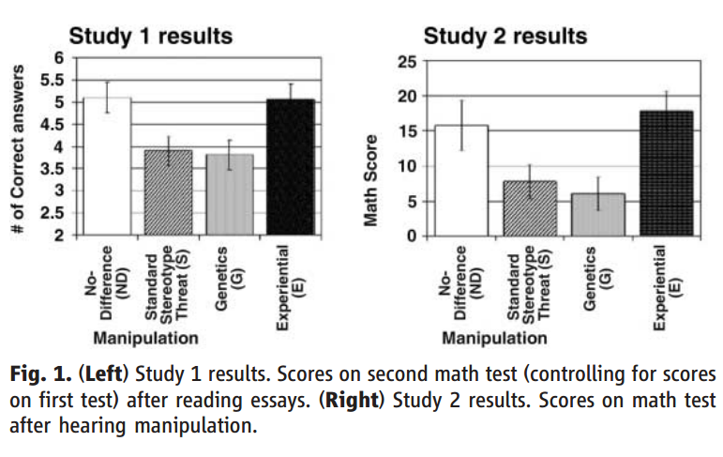
Notes:
People appear to habitually think of some sex differences in genetic terms unless they are explicitly provided with experiential arguments.

Slide 35
What could be the solutions?
Teaching about stereotype threat has shown to increase the performance of women. [link]
There are many examples of successful single sex schools (classes). [link]
Redesigning introductory computing courses in a way that they are more accessible to newcomers. Separating students into groups with accordance to their previous experience with computing. [link]
Organizing workshops for young women to teach them to code (e.g., Rails Girls) in a calm, non-pressuring atmosphere. [link]

Slide 36
Thank you for your attention! You are welcome to ask questions.

